Slide 1
Topic 4: Normal Linear Regression

Slide 2
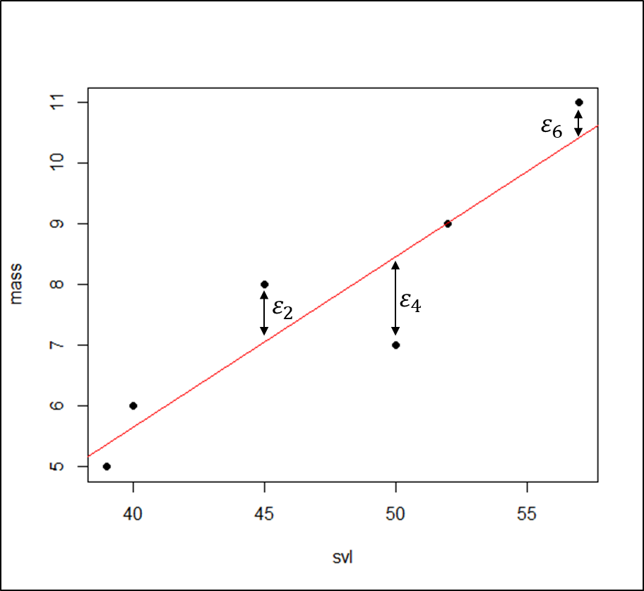
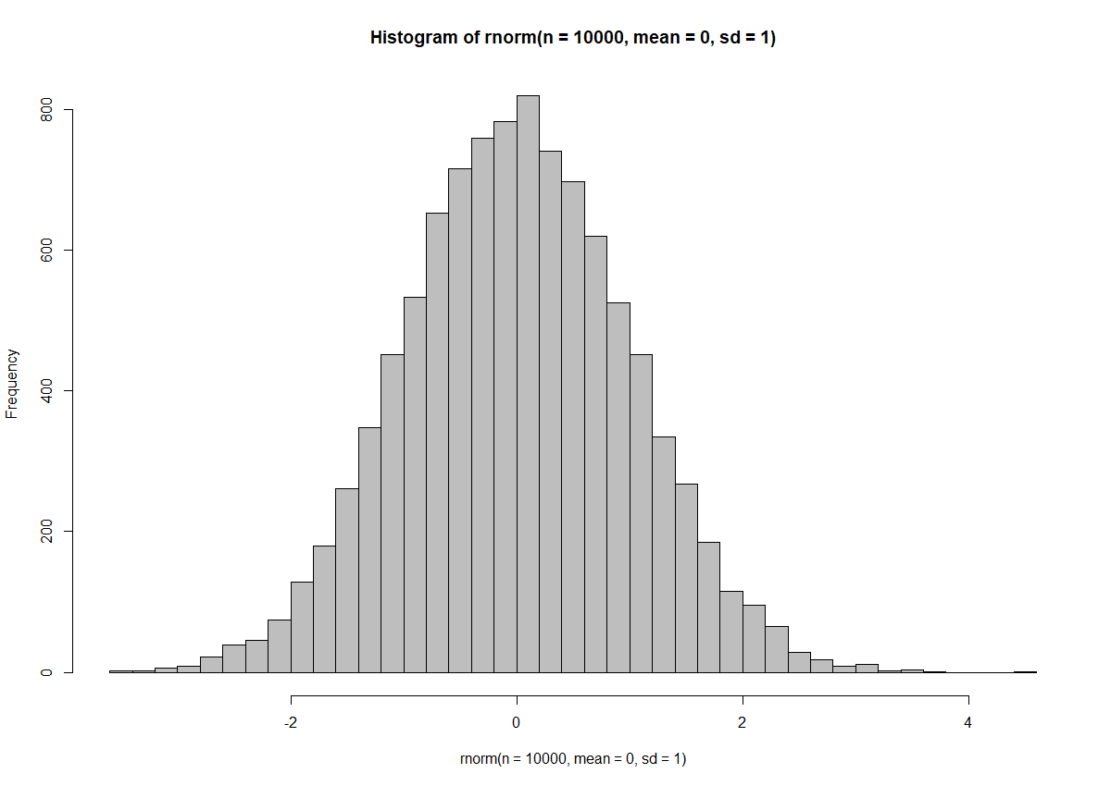
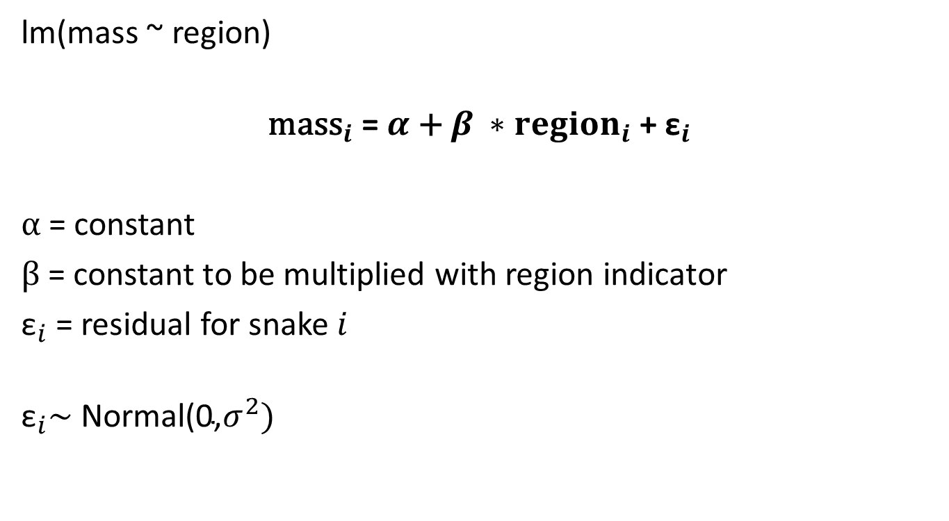
Recap: t-Test
lm(mass ~ region)
$${\text{mass}}_{i}\text{ = }α\text{ + }β ∗{region}_{i}\text{ + }{\text{ε}}_{i}$$
$α\text{ =}$ constant
$β\text{ =}$ constant to be multiplied with region indicator
${\text{ε}}_{i}$= residual for snake $i$
$${\text{ε}}_{i}\text{∼ }\text{Normal}\text{(0,}σ^{2})$$

Slide 3
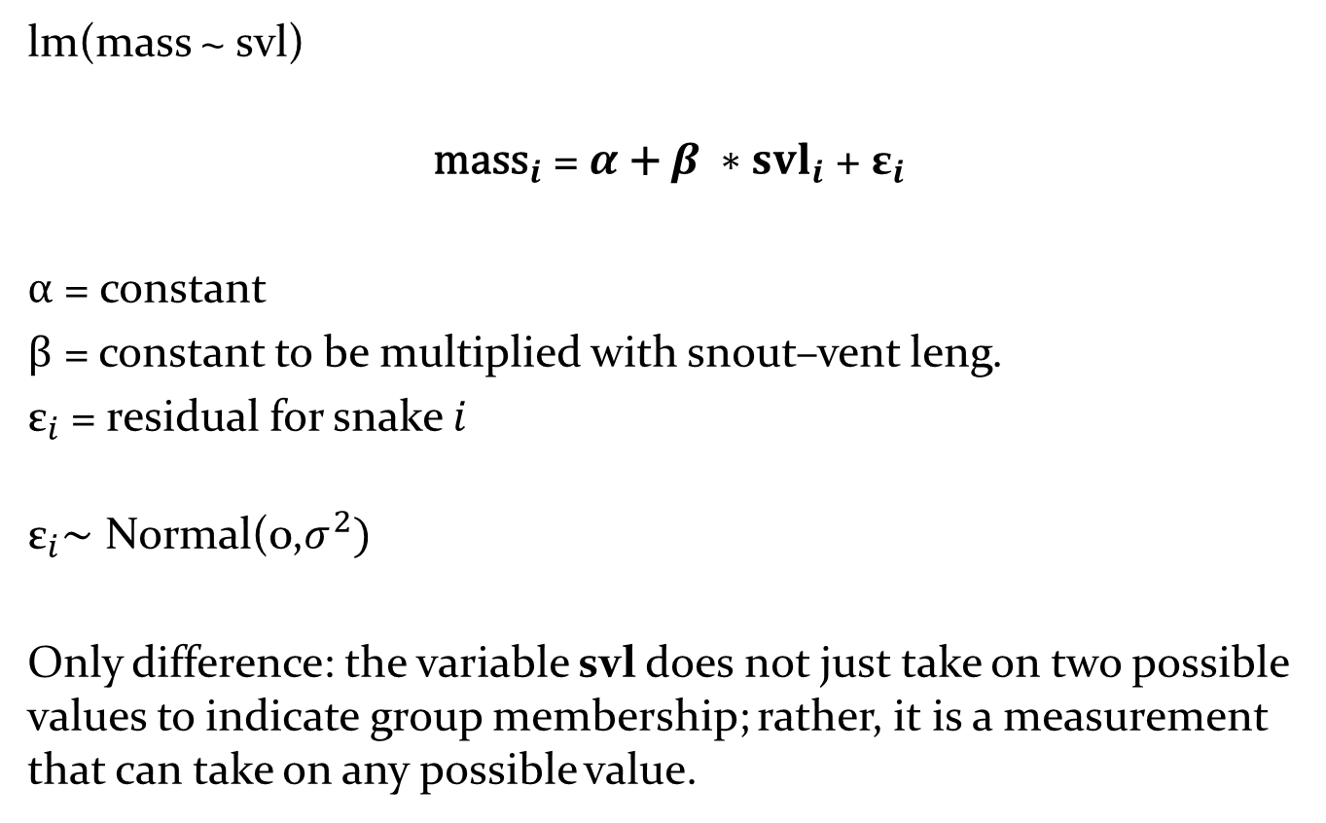
Recap: (simple) normal linear regression
lm(mass ~ svl)
$${\text{mass}}_{i}\text{ = }α\text{ + }β ∗{svl}_{i}\text{ + }{\text{ε}}_{i}$$
$α\text{ =}$ constant
$β\text{ =}$ constant to be multiplied with snout–vent leng.
${\text{ε}}_{i}$= residual for snake $i$
$${\text{ε}}_{i}\text{∼ }\text{Normal}\text{(0,}σ^{2})$$
Only difference: the variable svl does not just take on two possible values to indicate group membership; rather, it is a measurement that can take on any possible value.

Slide 4
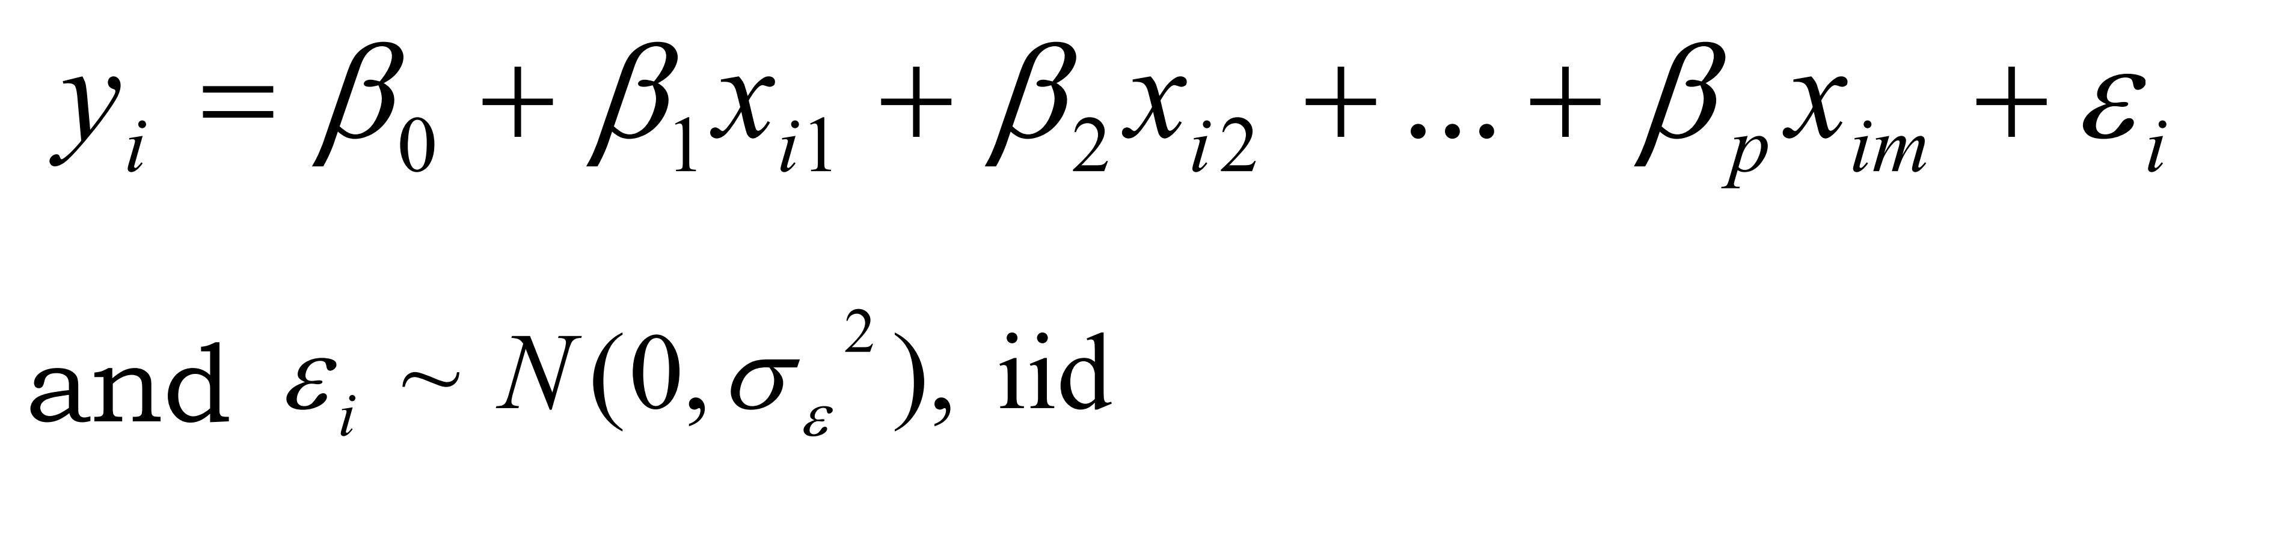

Simple/multiple linear regression
$$α$$
A relationship between variables involving:
A variable of interest Y_{i} (dependent variable, response variable); hard to measure
“easy to measure” variables (also called predictor, independent, or explanatory variables) - related to the variable of interest and here labeled x_{i1} , x_{i2},.....x_{im}
a single error term; a number of assumptions about the error term have been met

Slide 5
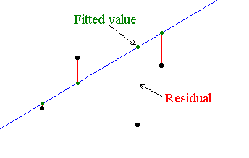
Normal linear regression
How to solve the equation?
Ordinary Least Squares, OLS (linear least squares) a method for estimating the unknown parameters in a linear regression model
OLS chooses the parameters of a linear function of a set of explanatory variables by minimizing the sum of the squares of the residuals
Linear model does not imply a straight line! E.g. a quadratic equation produces a curved line but the relationship between response and explanatory variables is still linear.

Slide 6
Model validation
Other key words: assumptions, residual analysis, diagnostics
Before you trust your model, you have to examine whether the assumptions on which the model is based are valid!
If the assumptions are not satisfied, then your model will be unreliable! (at least to some extent)

Slide 7
Key Assumptions
Assumptions are about the error term -> Residual analysis
Residuals are independently, identically distributed (iid)
1. The mean of the residuals is (close to) zero along the regression line, i.e. there is a linear relationship between dependent and independent variable
2. The residuals are normally distributed
3. The variances of the residuals are homogenous (homoscedasticity)
4. The model is not biased by unduly influencial observations
5. The independent variables are independent of each other (no collinearity)
6. The dataset does not contain serial auto-correlation

Slide 8
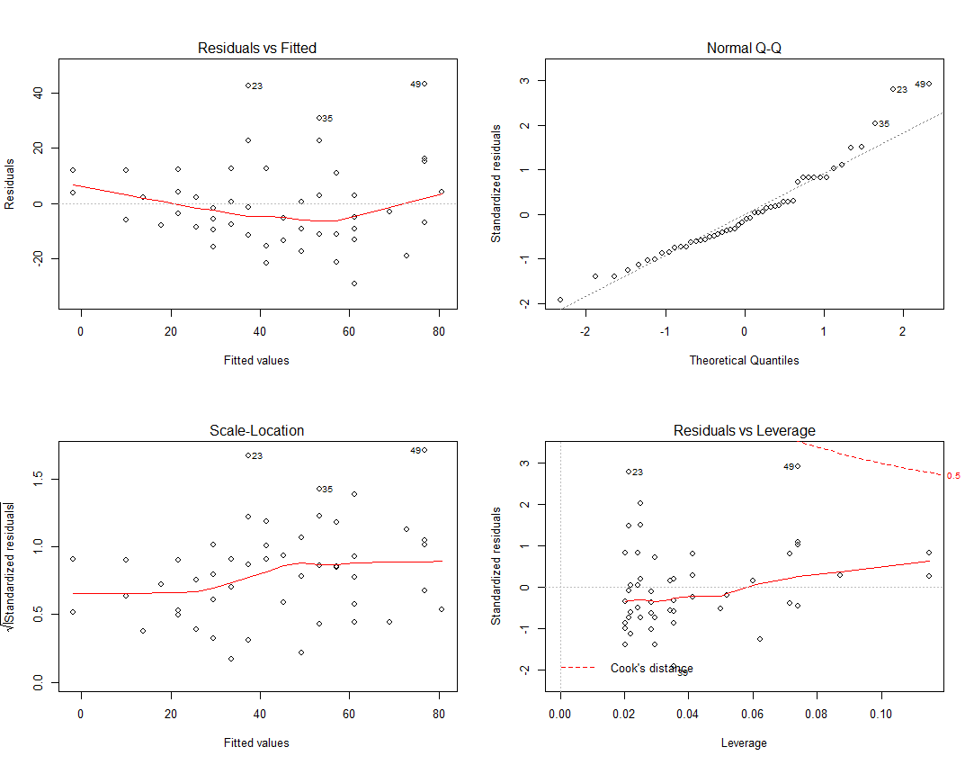
Residual analysis with diagnostic plots
R function for lm and glm object: plot(model)

Slide 9
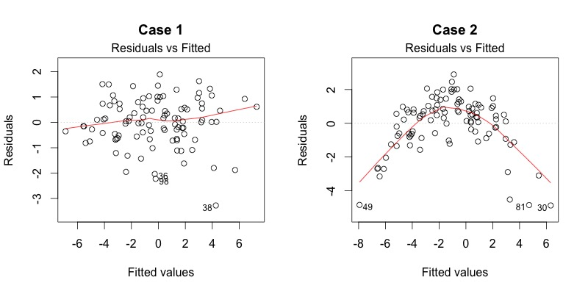
1. Residuals versus fitted values
We want to see…
no pattern and the red line is around zero (Patterns indicate non-linear relationship)
equally spreaded residuals around a horizontal line without distinct patterns
Good model
Bad model
http://data.library.virginia.edu/diagnostic-plots/

Slide 10
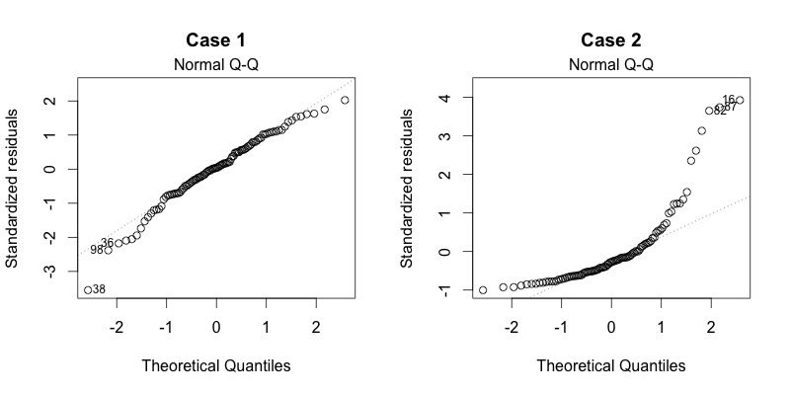
2. Normal Q-Q plot
Are residuals normally distributed?
Do residuals follow a straight line or do they deviate severely?
It’s good if residuals are lined well on the straight dashed line
Good model
But #38 might be a Problem!
Bad model
http://data.library.virginia.edu/diagnostic-plots/

Slide 11
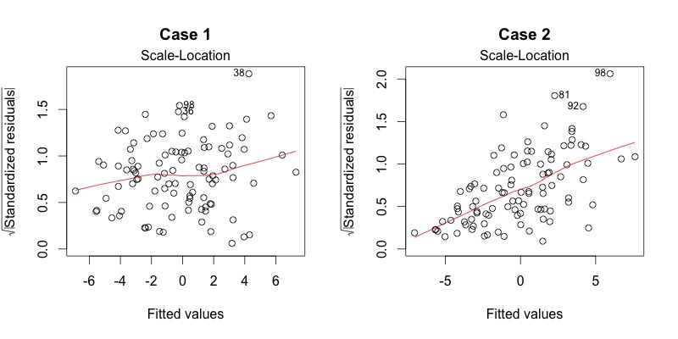
3. Scale-Location plot
Are residuals spread equally along the ranges of predictors?
Checks the assumption of equal variance (homoscedasticity).
It’s good if you see a horizontal line with equally (randomly) spread points.
Good model
Bad model
http://data.library.virginia.edu/diagnostic-plots/

Slide 12
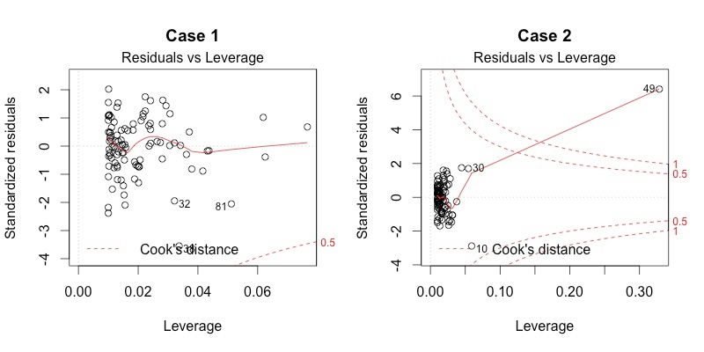
4. Residuals versus Leverage
helps to find influential cases (not all outliers are influential in linear regression analysis) - Here, patterns are not relevant
Watch out for outlying values at the upper right corner or at the lower right corner. -> high Cook’s distance scores: cases are outside of a dashed line. Such cases are influential to the regression results, which will be altered if we exclude those cases.
Good model
Bad model
http://data.library.virginia.edu/diagnostic-plots/

Slide 13
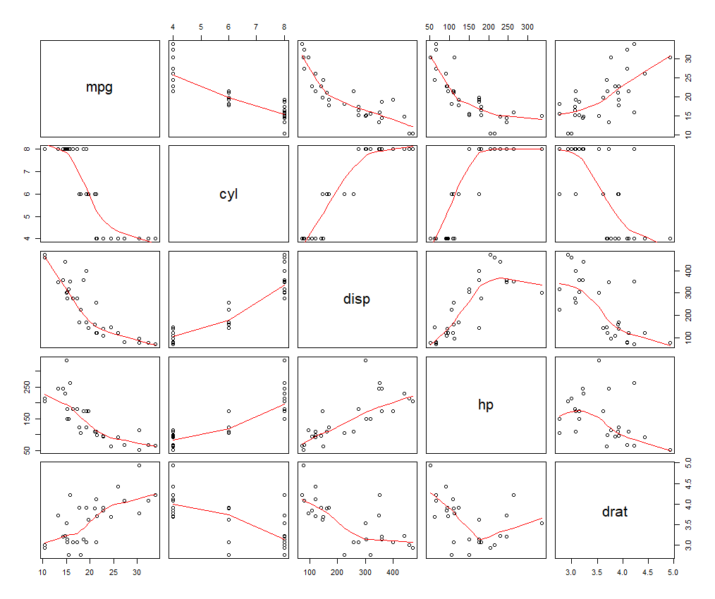
5. Check for Collinearity
Collinearity is where two independent variables are strongly correlated with each other
Should be checked aready before running a model!
Graphically: plot(dataframe, panel=panel.smooth) pairs(dataframe)
Pearson correlation coefficient: cor(dataframe) however unclear when is correlation too large, e.g. r > 0.6 or 0.8?
After running a model: Variance Inflation Factor (VIF) How much variation is already explained by other variables?
library(car) vif(model)
VIF should be < 4, the smaller the better

Slide 14
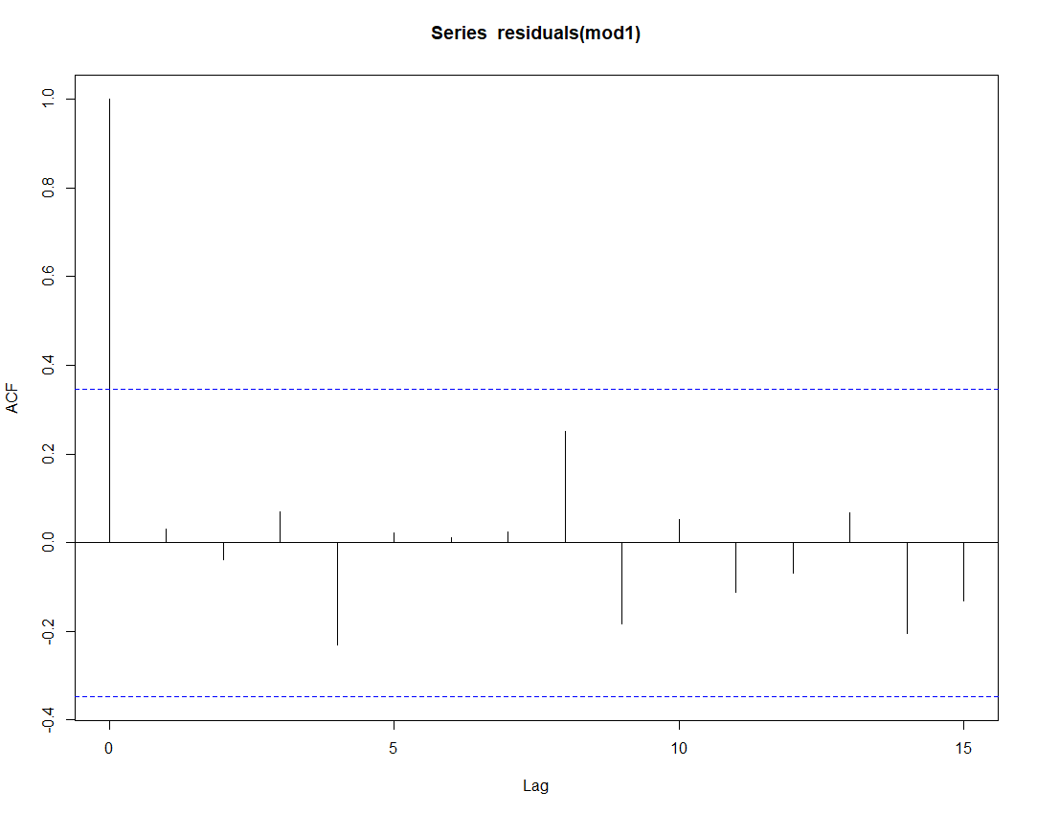
6. Autocorrelation
The correlation between successive datapoints in the dataset (or residuals in the model) - especially applicable for time series
Graphical check: Auto-Correlation Function (ACF)
acf(residuals(model))
acf(variable)
X axis = lags of residuals/variable, increasing in steps of 1; first line left is the correlation of residual with itself (Lag 0)
When ACF score for a lag value exceeds horizontal dotted lines -> significant auto-correlation at that time-lag
Statistical test: durbinWatsonTest(model) from library(car) p-value < 0.05 indicates significant auto-correlation

Slide 15
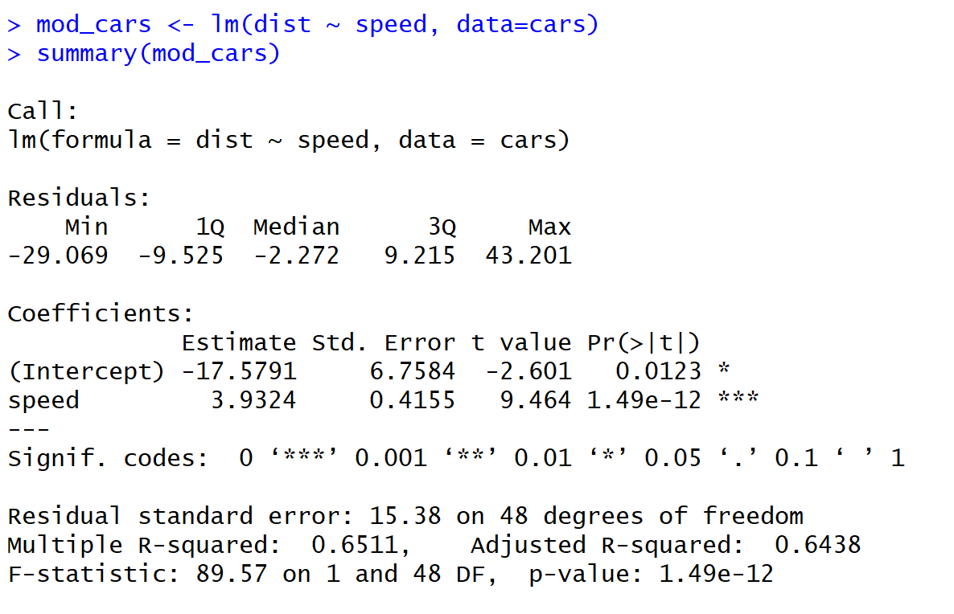
Interpreting model coefficients
Example with dataset cars: Can „dist“ (Stopping distance) be predicted by „speed“?

Slide 16
Interpreting model coefficients
Output in R from function summary() after using e.g. lm()
Formular call - the formula R used to fit the data.

Slide 17
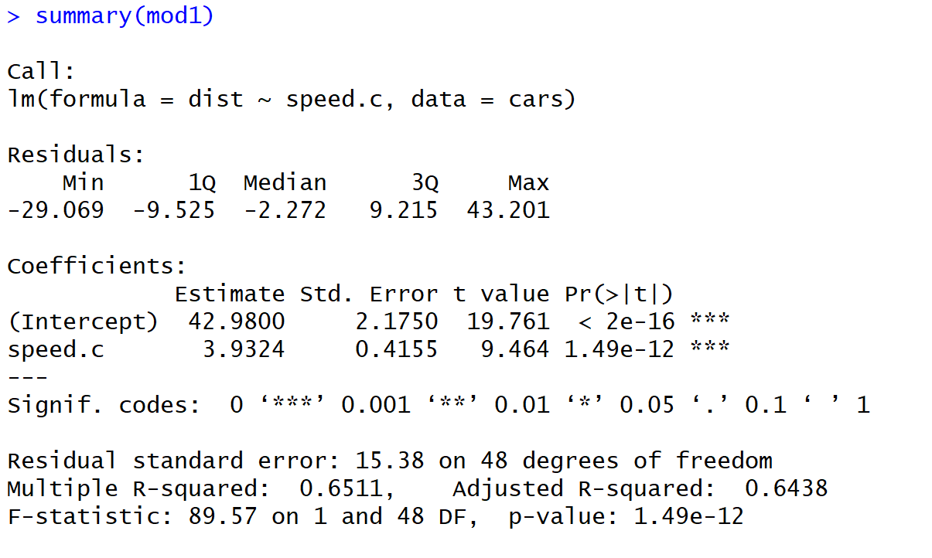
Interpreting model coefficients
Rough summary of residual distribution
First impression whether residuals are normally distributed

Slide 18
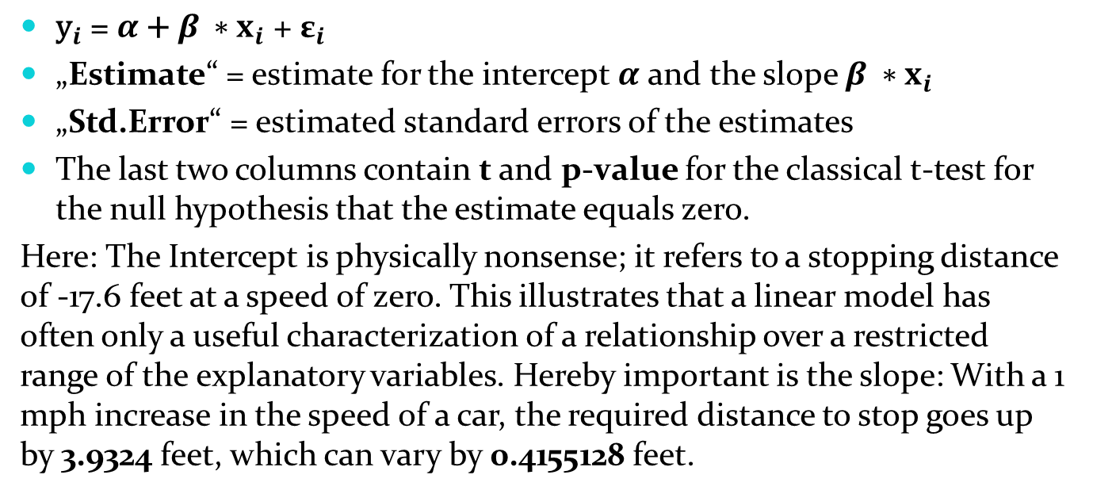
Interpreting model coefficients
${\text{y}}_{i}\text{ = }α\text{ + }β ∗x_{i}\text{ + }{\text{ε}}_{i}$
„Estimate“ = estimate for the intercept $α$ and the slope $β ∗x_{i}$
„Std.Error“ = estimated standard errors of the estimates
The last two columns contain t and p-value for the classical t-test for the null hypothesis that the estimate equals zero.
Here: The Intercept is physically nonsense; it refers to a stopping distance of -17.6 feet at a speed of zero. This illustrates that a linear model has often only a useful characterization of a relationship over a restricted range of the explanatory variables. Hereby important is the slope: With a 1 mph increase in the speed of a car, the required distance to stop goes up by 3.9324 feet, which can vary by 0.4155128 feet.

Slide 19
Interpreting model coefficients
Residual Standard Error is a measure of the quality of a linear regression fit.
Average amount that the response (dist) will deviate from the true regression line.
Here: the actual distance required to stop can deviate from the true regression line by approximately 15.38 feet, on average.
Degrees of freedom are the number of data points that went into the estimation of the parameters (after taking into account these parameters). Here: 50 data points and two parameters (intercept and slope).

Slide 20
Interpreting model coefficients
The R-squared statistic provides a measure of how well the model is fitting the actual data.
R² is a measure (0-1) of the linear relationship between our predictor variable (speed) and our response variable (dist).
Here: Roughly 65% of the variance found in the response variable (dist) can be explained by the predictor variable (speed).
In multiple regressions: R² will always increase as more variables are included in the model. Use the adjusted R²!

Slide 21
Interpreting model coefficients
F-statistic is a good indicator of whether there is a relationship between our predictor and the response variables. The further the F-statistic is from 1 the better it is.
However, how much larger the F-statistic needs to be depends on both the number of data points and the number of predictors. E.g. in a large dataset the F-statistic only needs to be a little larger than 1 to reject the null hypothesis.

